Slide 1
GROUP 3 An Analysis on
Customer Purchase
Nu’man bin Badrud’din
Wan Nazirul Hafiz bin Abd Rani
Ahmad Danish bin Abd Wahab
Muhammad Muadz bin Mohammad Azmi

Slide 2

$143,021.55
Total Purchase Over The Last 3 Years
Indirect Purchase $80,922.64

Slide 3
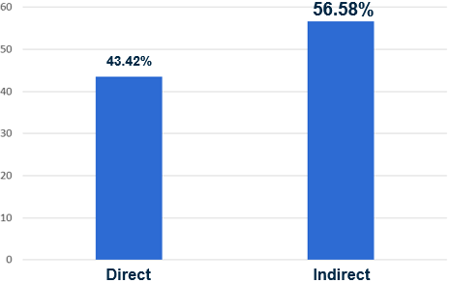
3 years Direct Purchase Vs Indirect Purchase
Indirect purchase is higher than direct purchase

Slide 4
$381,981.50
Total Purchase Over The Last 5 Years

Slide 5


Customers Demographic
Gender
3,618
Customers
Age
>60
38.6%
53.12%
Female
41-60
49.5%
42.29%
Male
21-40
10.7%
4.59%
Unknown
5-20
1.2%

Slide 6

Customer Spending (Over 3 Years)
Total Spend = $83,332
Total Order = 6091
2146
Total Spend = $46,132
Total Order = 5027
964
219
207
72
10
Active
Star
First Time
New
Inactive
Lapsing

Slide 7

Gender Vs Annual Income
40,000
30,000
Annual Income
20,000
No significant different
10,000
Female
Male
Gender

Slide 8

3.5
3.0
Gender Vs No Purchase
Over 3 Years
2.5
2.0
No Purchase Over 3 Years
1.5
1.0
No significant different
0.5
0.0
Female
Male
Gender

Slide 9

14
Gender Vs Average Purchase
Over 3 Years
12
10
8
Average Purchase Over 3 Years
6
4
No significant different
2
0
Female
Male
Gender

Slide 10

40
35
Gender Vs Total Purchase
Over 3 Years
30
25
Total Purchase Over 3 Years
20
15
10
No significant different
5
0
Female
Male
Gender

Slide 11
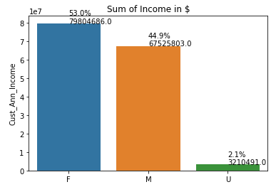
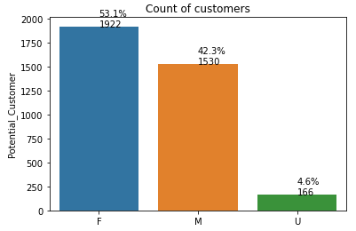
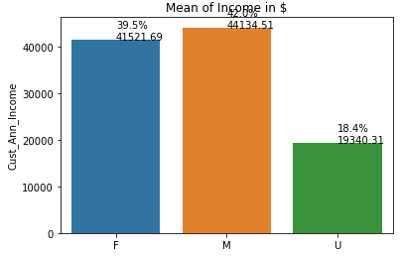
Gender breakdown on Sum vs Mean
F: Female
M: Male
U: Unknown
Explaination:
- Female buyer count is greater than Male buyer
- Female buyer has greater sum of income than Male buyer
- However, both male and female buyer has around the same value of mean
- This example used income as comparison, it is the same with total amount of purchase in 3 years

Slide 12
EDA

Slide 13
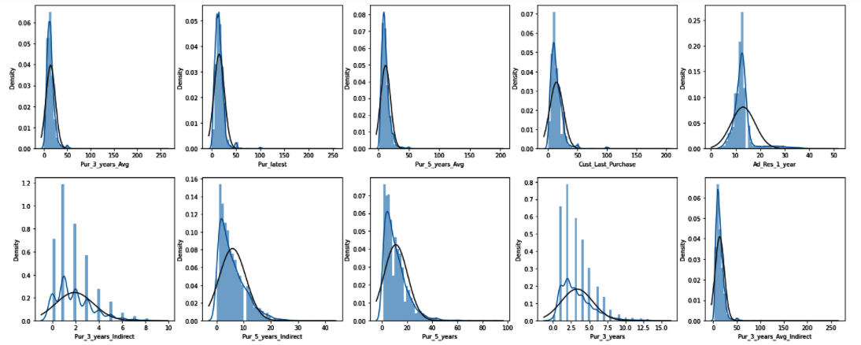
Features with Skewness
Pur_3_years_Avg
Pur_latest
Pur_5_years_Avg
Cust_Last_Purchase
Ad_Res_1_year
Pur_3_years_Indirect
Pur_5_years_Indirect
Pur_5_years
Pur_3_years
Pur_3_years_Avg_Indirect

Slide 14
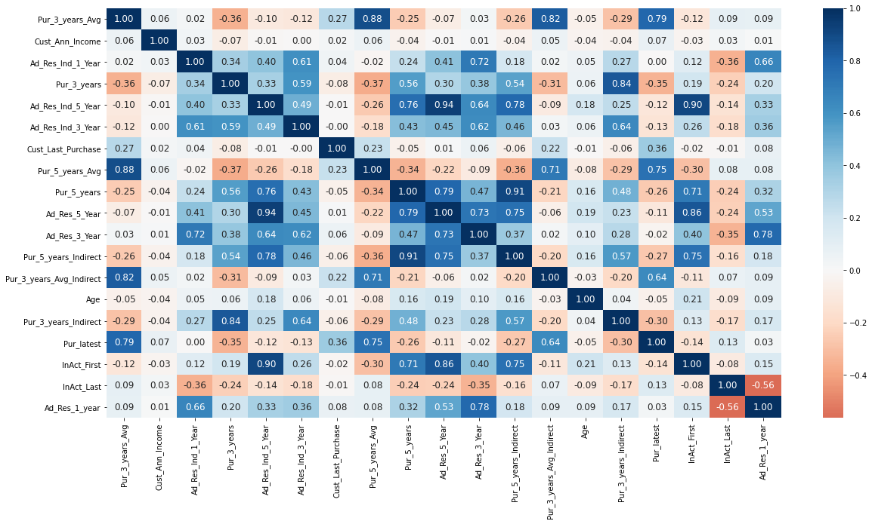
Correlation between the features

Slide 15
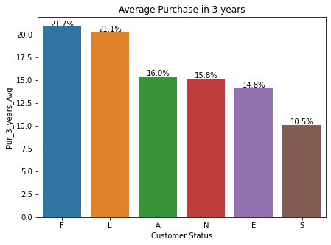
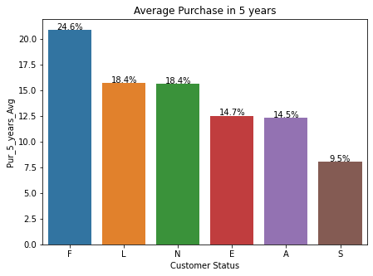
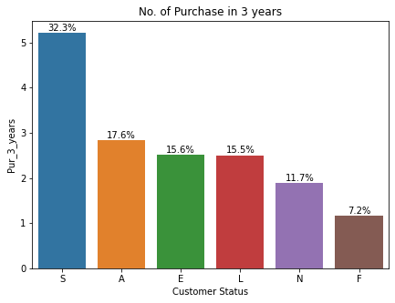
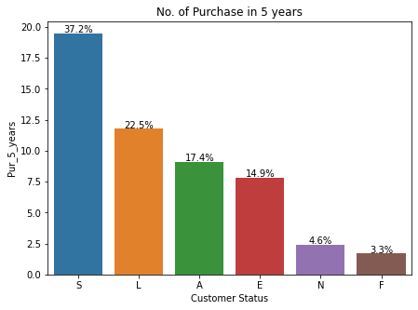
Customer Status Breakdown
A: Active buyer
S: Star buyer
N: New buyer
E: Inactive buyer
F: First time buyer
L: Lapsing buyer
In both 3 years and 5 years:
- First time buyer has the highest average purchase
- Star buyer has the highest number of purchase

Slide 16
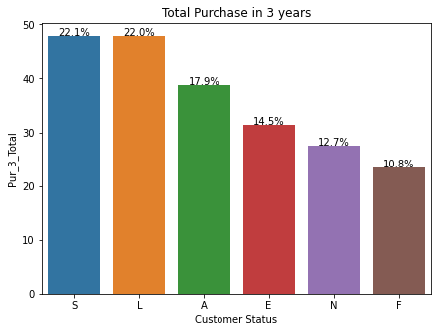
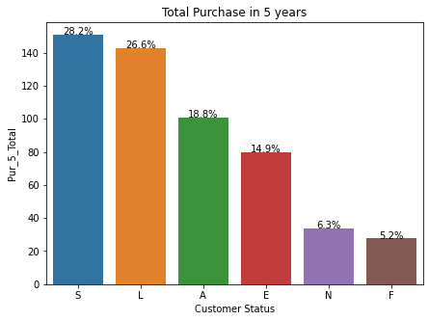
Customer Status Breakdown
A: Active buyer
S: Star buyer
N: New buyer
E: Inactive buyer
F: First time buyer
L: Lapsing buyer
In both 3 years and 5 years:
- First time buyer has the highest average purchase
- Star buyer has the highest number of purchase
BUT
In terms of total purchase, Star buyer is the highest while
First time buyer is the lowest

Slide 17
Customer Status Breakdown
A: Active buyer
S: Star buyer
N: New buyer
E: Inactive buyer
F: First time buyer
L: Lapsing buyer
In both 3 years and 5 years:
- First time buyer has the highest average purchase
- Star buyer has the highest number of purchase
BUT
In terms of total purchase, Star buyer is the highest while
First time buyer is the lowest.

Slide 18
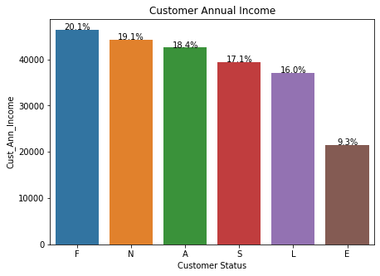
Customer Status Breakdown
A: Active buyer
S: Star buyer
N: New buyer
E: Inactive buyer
F: First time buyer
L: Lapsing buyer
Inactive buyer has the lowest annual income,
which might explain why they are inactive.

Slide 19
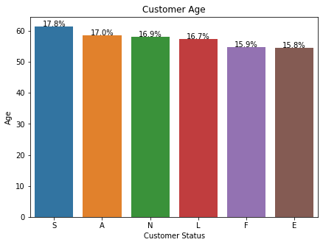
Customer Status Breakdown
A: Active buyer
S: Star buyer
N: New buyer
E: Inactive buyer
F: First time buyer
L: Lapsing buyer
All customer status has about the same average age,
signifying that
age is not a factor in deciding their status.

Slide 20
Machine Learning

Slide 21
Preprocessing Method Used
-PCA(number of components = 7)
-Replace missing data
-Null data replace with 0 (Cust_Last_Purchase)
-Null skewed data replace with median
-Null non skewed data replace with mean
- StandardScaler

Slide 22
Methods:
Create dummy variables for categorical columns
Split X,y
Scale the data for train and test
Apply PCA for train and test
Concat dummy variables and selected PCA dimensions
Apply machine learning algorithms

Slide 23
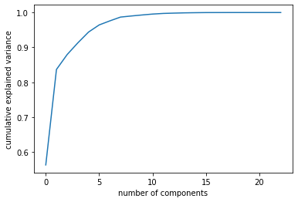
PCA dimensions
With 5 no of components,
±95% variance can be explained

Slide 24
Results
Decision Tree:
Accuracy on training set: 0.558
Accuracy on test set: 0.577
Decision tree best param.: {'max_depth': 2}
Decision tree best score: 0.553
(Parameter, cv=5, scoring=’roc_auc’)
SVM:
Model accuracy: 0.55
Logistic Regression:
Accuracy on Train: 0.581
Accuracy on Test: 0.560
LogisticRegression Best param.: {'C': 0.1, 'fit_intercept': False, 'penalty': 'l2'}
LogisticRegression best score: 0.591

Slide 25
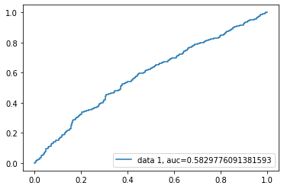
Results
Logistic Regression with PCA & scaling:
Accuracy on Train: 0.581
Accuracy on Test: 0.560
Logistic Regression without PCA & scaling:
Accuracy: 0.566
Precision: 0.513
Recall: 0.552
ROC-AUC Score

Slide 26
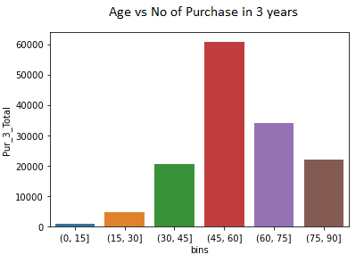
Suggestion To Increase Purchase
Focus more on (45-60) age group as they are the largest group.

Slide 27
Idea to improve for future analysis
Outlier removal
Attempt other machine learning methods

Slide 28
THANKS
Do you have any questions?
This presentation is prepared by Nu’man, Danish, Nazirul and Muadz

